Slide 1
Find the best location to open new coffee shop in Singapore
The Problem of the Neighbourhoods Project

Slide 2
The business Problem
This project aims to find the optimal location for a new coffee shop in Singapore.
The main audience will be the stakeholders of the project.

Slide 3
Our approach
We will try to find locations that are not already crowded with coffee shops, and are close to the city centre.
Based on the goal of this project, we will need to identify:
number of existing coffee shops in the neighbourhood
number of and distance to coffee shops in the neighbourhood, if any, and
distance of neighbourhood from city centre

Slide 4
Data source
Google Maps API reverse geocoding to obtain centres of candidate areas and approximate addresses of these centres
Foursquare API to derive number of coffee shops and location in every neighbourhood
Google Maps Geocode API to acquire coordinate of Singapore centre

Slide 5
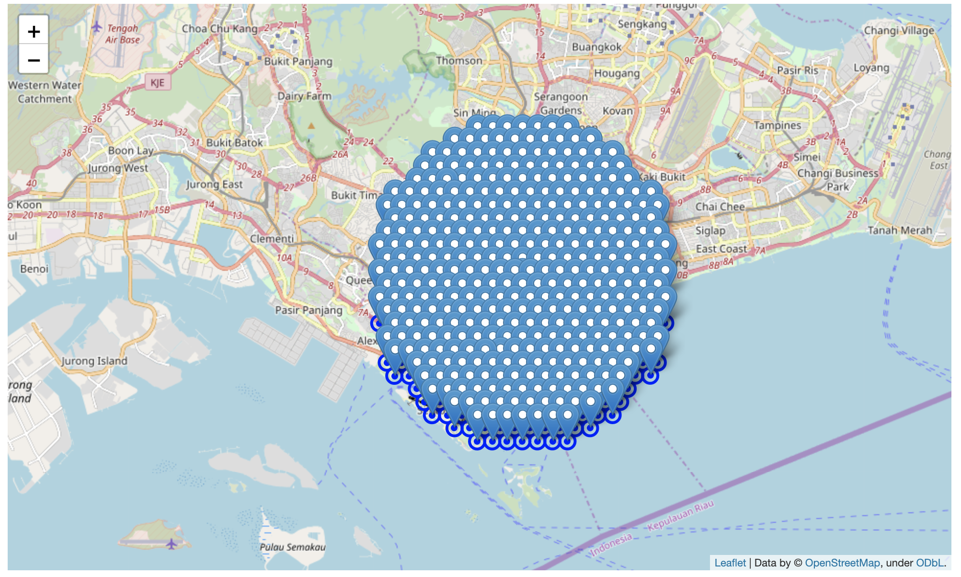
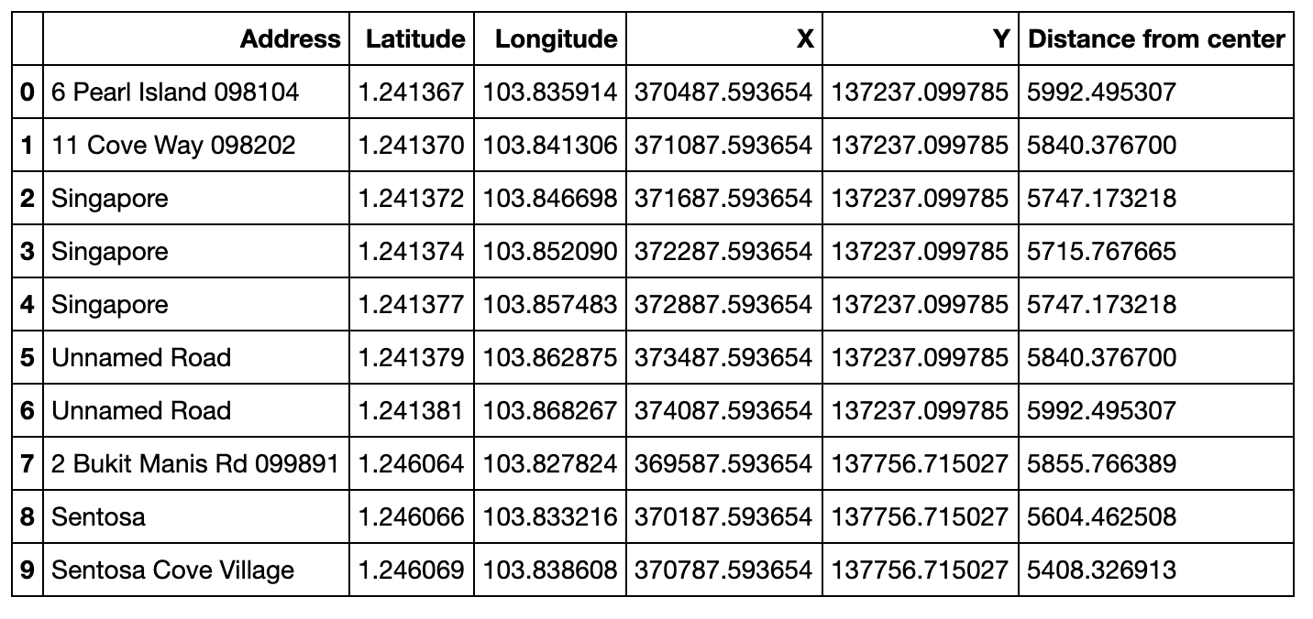
Neighborhood candidates
We identified 364 neighborhoods, with a radius of 300 meters, within 6km from city center.
...
Data source: Google Map API

Slide 6
Foursquare query
By using Foursquare database, we are able to identify in the area:
Total number of restaurants: 584
Total number of coffee shops: 97
Percentage of coffee shops: 16.61%
Average number of restaurants in neighbourhood: 1.39

Slide 7
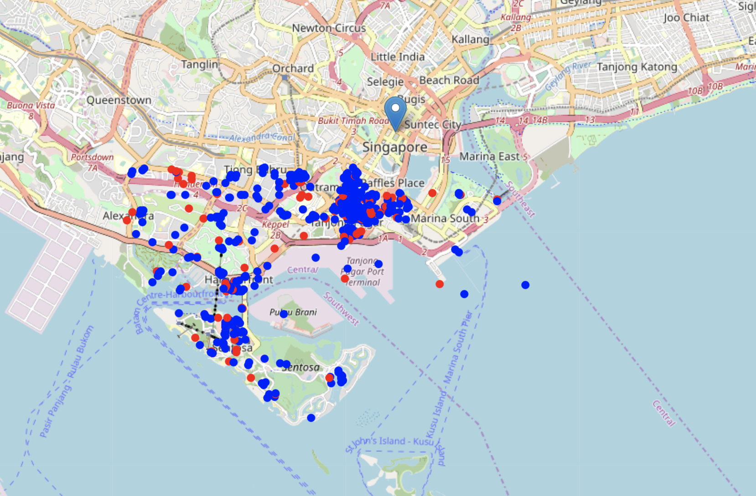
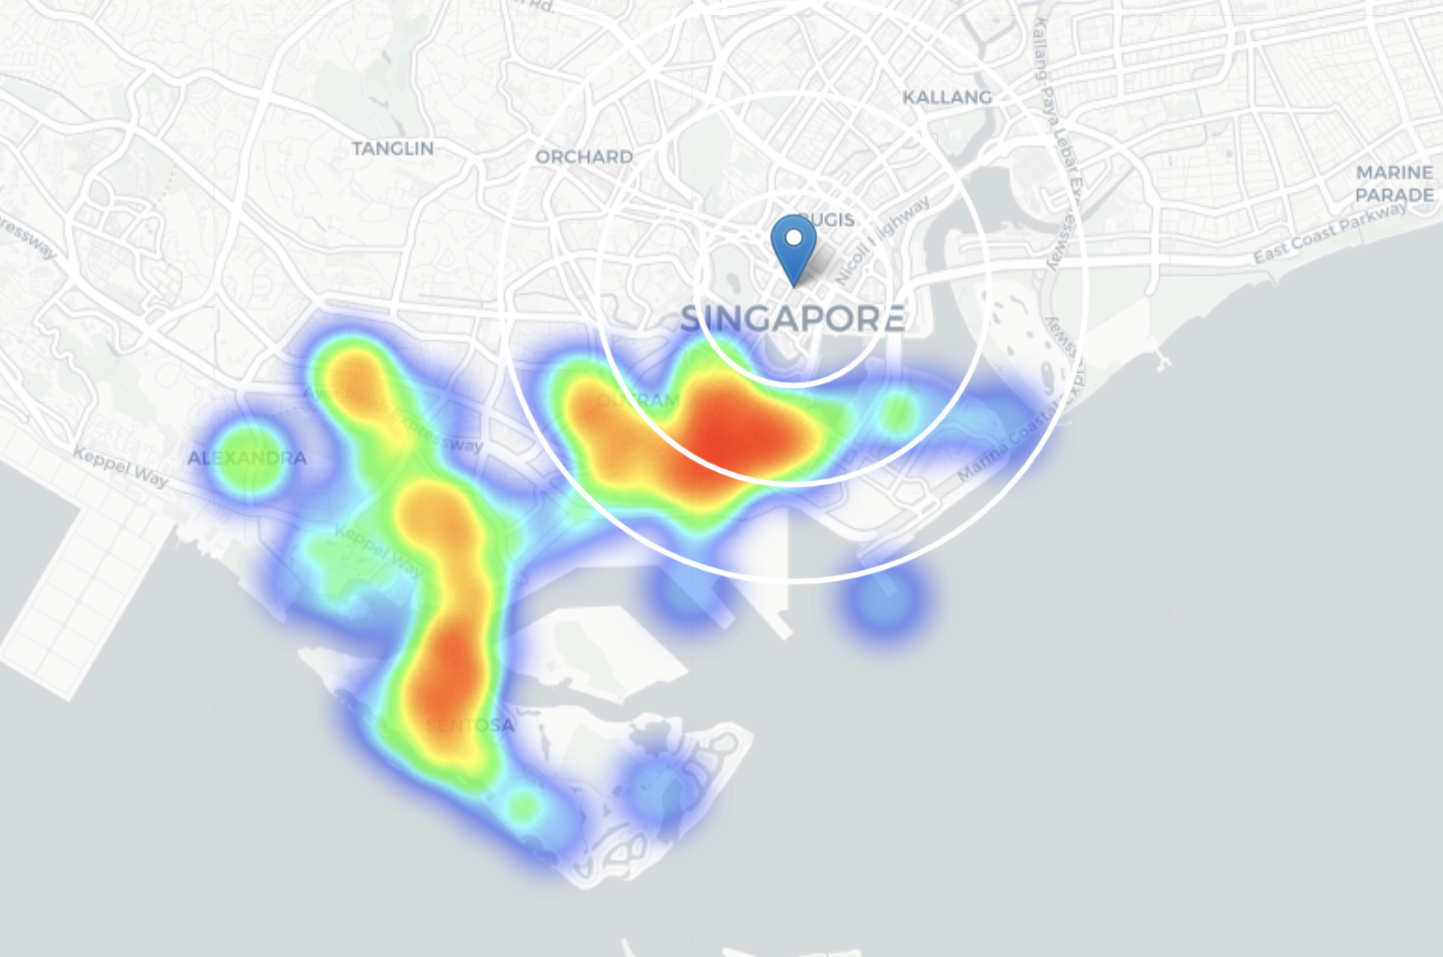
The existing restaurants and coffee shops
We then identified the existing restaurants (blue) and coffee shops (red), and a heap map reveals possible areas

Slide 8
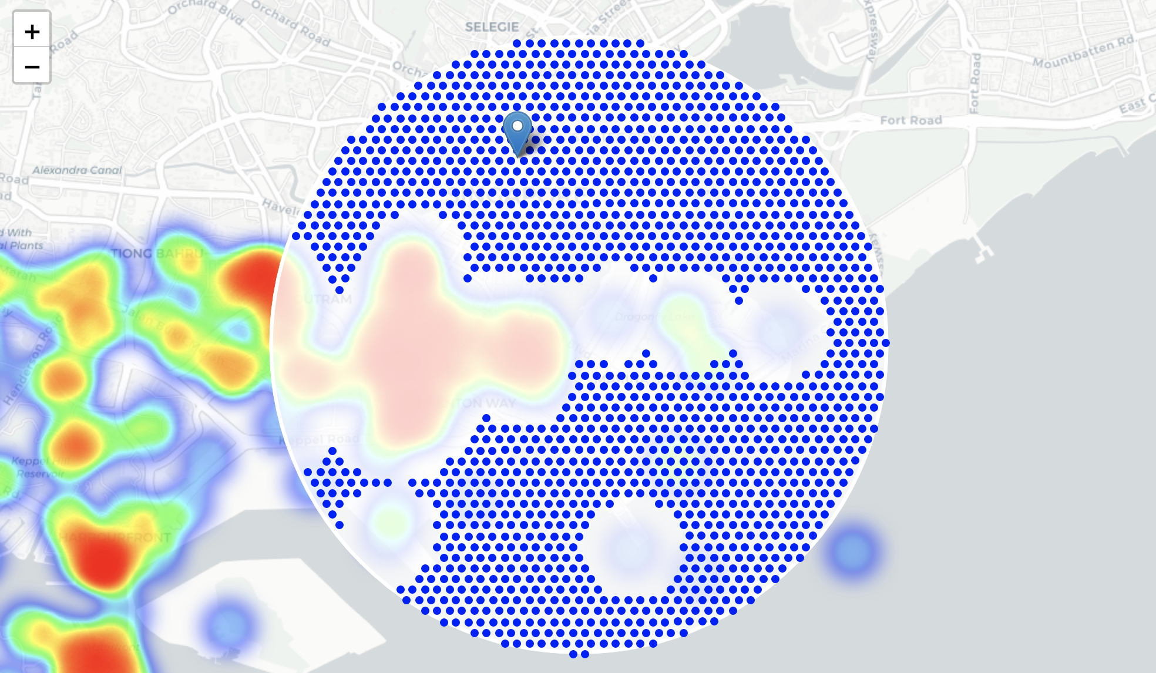
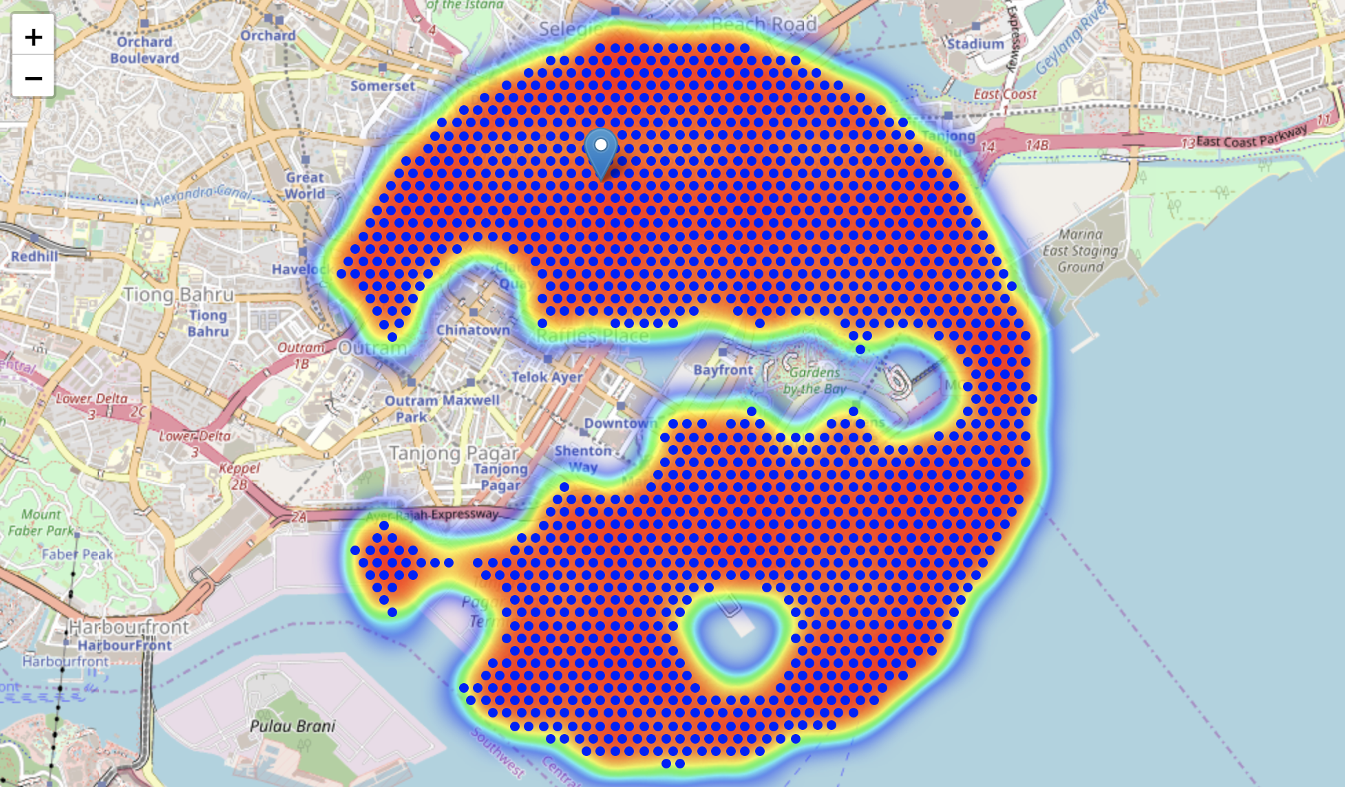
Heat map of potential areas
We then generate heatmaps that clearly show the potential areas with less crowded restaurants and coffee shops

Slide 9
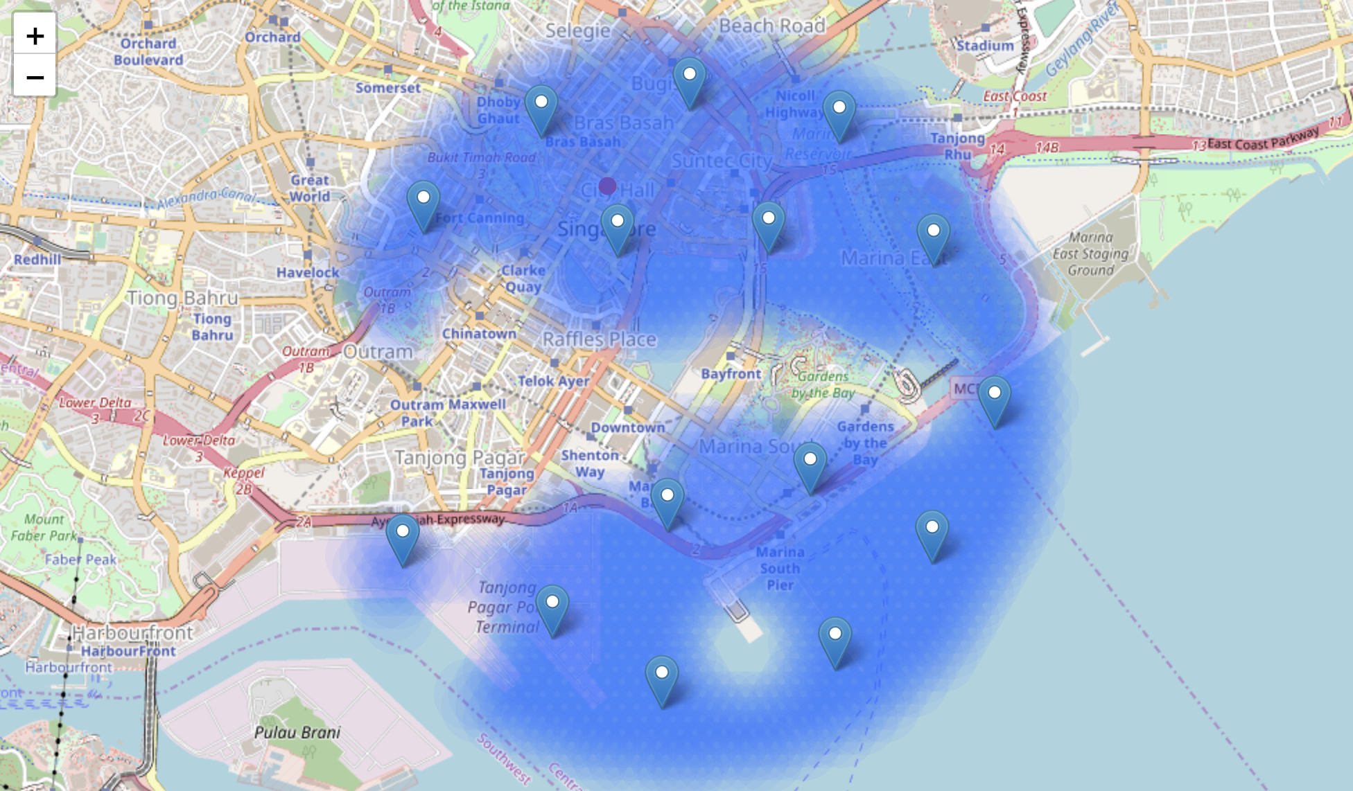
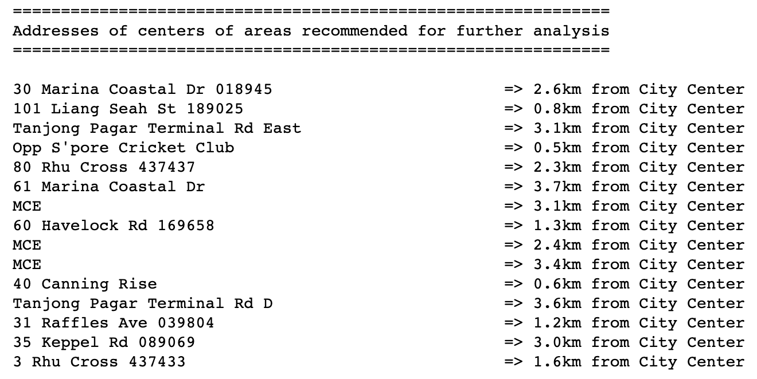
Cluster the potential areas
A cluster analysis revealed the top neighborhoods with less competitors

Slide 10
conclusion
No | Address | Distance to City Centre
1 | 101 Liang Seah St 189025 | 0.8 km
2 | Opp S'pore Cricket Club | 0.5 km
3 | 40 Canning Rise | 0.6 km
The above three are the selected top locations to open a new coffee shop.
Thank you for your interests in this project!

